Slide 1
Fuzzy Based Expert System
Introduction
Fuzzy - difficult to realize/understand
Expert system - A computer system imitating the decision-making ability of a human expert.
A fuzzy expert system is an expert system that uses fuzzy logic instead of Boolean logic.
In other words, a fuzzy expert system is a collection of membership functions and rules that are used to reason about data.
The idea of fuzzy logic was first advanced by Dr. Lotfi Zadeh of the University of California at Berkeley in the 1960s.
Boolean Logic is a form of algebra which is centered around three simple words known as Boolean Operators: Or, And, and Not. At the heart of Boolean Logic is the idea that all values are either true or false.
1 (true)
0 (false)

Slide 2

Fuzzy logic is a form of many-valued logic in which the truth values of variables may be any real number between 0 and 1 inclusive. It is employed to handle the concept of partial truth, where the truth value may range between completely true and completely false.
Where is fuzzy logic used?
Suppose, we want to measure the temperature of water.
One way we can say is – Either it is hot or cold.
But other way, we can say that –
It is very hot or
It is hot or
It is normal or
It is cold or
It is very cold
Hence, we can say that fuzzy logic is used for acceptable reasoning which may not give accurate reasoning
if temperature<=0 degree Celsius then it is very cold.
If temperature>-10 and temperature<=20 then it is cold.
If temperature>10 and temperature<40 then it is normal.
If temperature>30 and temperature<=60 then it hot.
If temperature>50 then it is very hot.

Slide 3
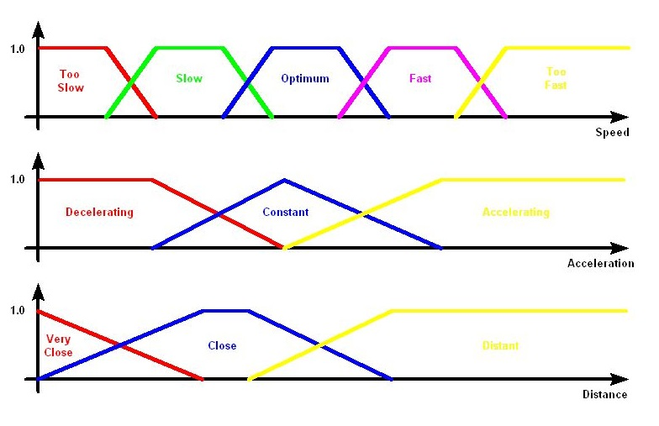
Fuzzy Logic Example

Slide 4


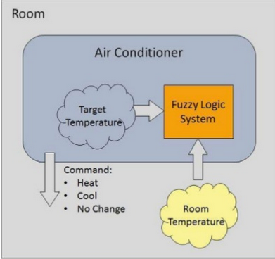
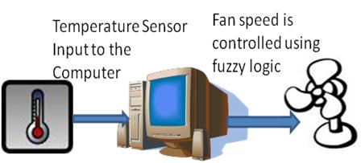
Applications
Automatic Car.
Train Schedule Control
Medical
Electric Fan
Regulator
Brightness of screen
Pollution measuring
Electric Iron
Washing Machines
Altitude Control of spacecraft
Image processing
and so on
Very Far
Very Near
Far
Near

Slide 5
Advantages
Similar to Human Reasoning
Based on Linguistic Model
High Precision
Ability to deal with uncertainty
Disadvantages
Tedious to develop fuzzy rules and member function
For more accuracy, needs more fuzzy grades
Lower speed and longer run time of system

